Slide 1
Zoekend lezen
Where is Waldo??

Slide 3
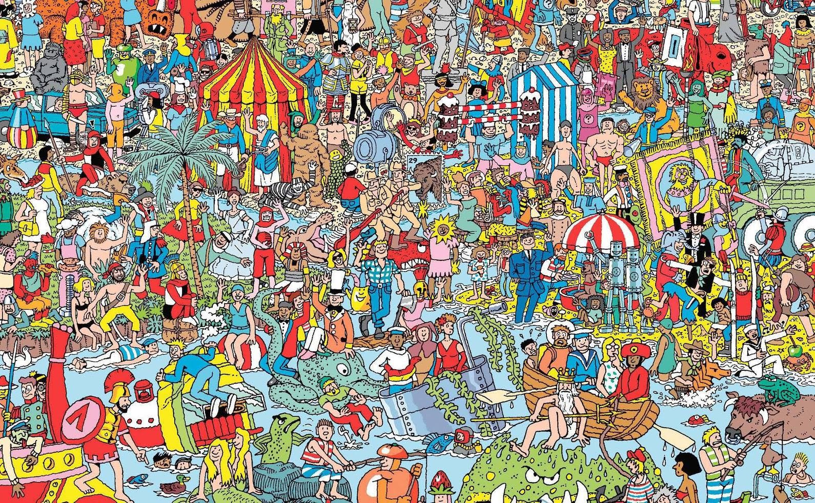

Slide 4
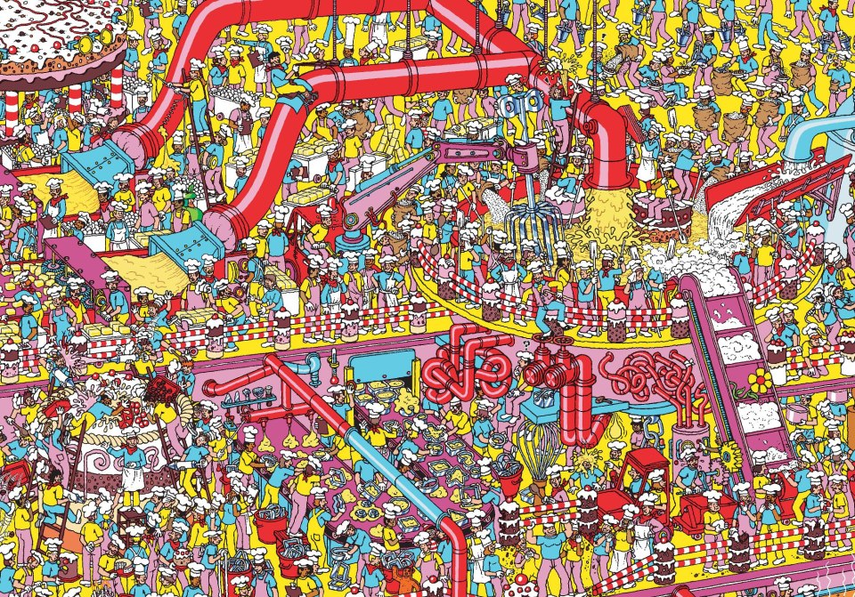

Slide 5
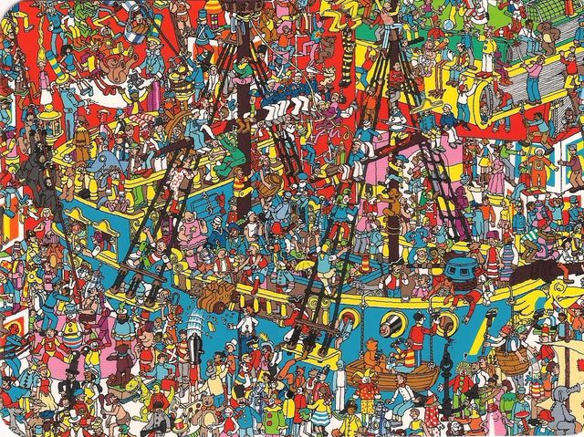

Slide 6
